Slide 2
Casting Our
Net
Luke 5:1-11

Slide 3
We have no greater purpose in life than to follow Jesus and catch men for Him.

Slide 4
7 truths about following Jesus and making disciples:

Slide 5
Following Jesus is never a small thing.

Slide 6
Following Jesus is never routine.

Slide 7
Following Jesus may seem unrealistic, even unfair.

Slide 8
Following Jesus
is simply taking God at His Word.

Slide 9
Following Jesus can lead to great blessing.

Slide 10
Following Jesus can allow others to share in the blessing.

Slide 11
Following Jesus
allows you to share in God’s great work throughout the world.

Slide 12
New Sunday PM schedule beginning September 1
Maximizing our
SUNDAY EVENINGS
For the purpose of following the command of Christ to make disciples

Slide 13
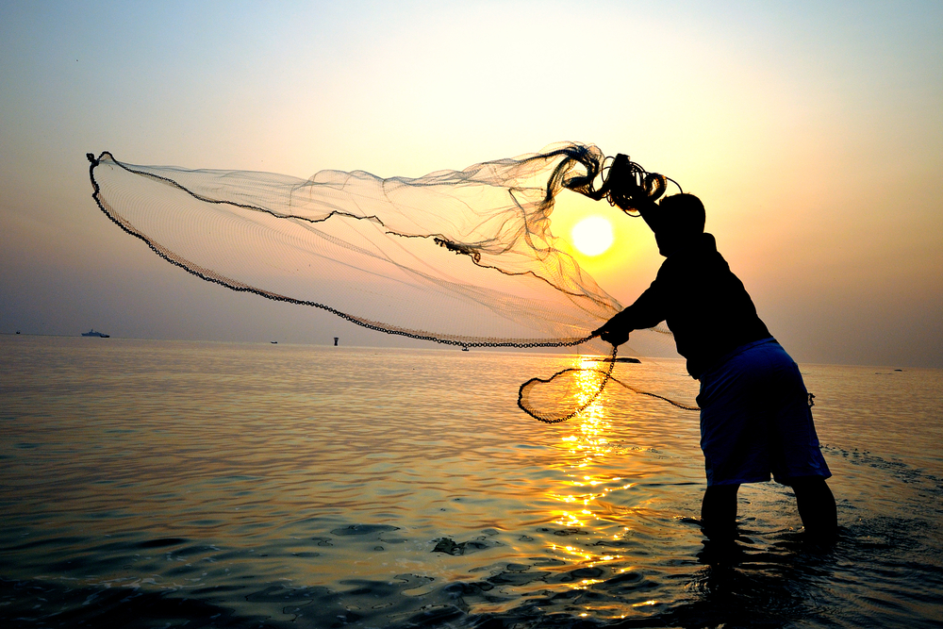
Casting our nets to catch people and make disciples
We must be:
Deliberate
Determined
Decisive
Devoted

Slide 14
 | GOAL | REASON
D
I
S
C
I
P
L
E

Slide 15
 | GOAL | REASON
D | Do | Allow more of our people to be doers of the Word
I
S
C
I
P
L
E

Slide 16
 | GOAL | REASON
D | Do | Allow more of our people to be doers of the Word
I | Increase | Expand our opportunity for ministry and more ministries
S
C
I
P
L
E

Slide 17
 | GOAL | REASON
D | Do | Allow more of our people to be doers of the Word
I | Increase | Expand our opportunity for ministry and more ministries
S | Steward | Better stewards of time (God’s, others’, and ours’)
C
I
P
L
E

Slide 18
 | GOAL | REASON
D | Do | Allow more of our people to be doers of the Word
I | Increase | Expand our opportunity for ministry and more ministries
S | Steward | Better stewards of time (God’s, others’, and ours’)
C | Center | Not doing away with ministry – strategic focus for more
I
P
L
E

Slide 19
 | GOAL | REASON
D | Do | Allow more of our people to be doers of the Word
I | Increase | Expand our opportunity for ministry and more ministries
S | Steward | Better stewards of time (God’s, others’, and ours’)
C | Center | Not doing away with ministry – strategic focus for more
I | Innovate | Transforming our methods to reach/minister to more people
P
L
E

Slide 20
 | GOAL | REASON
D | Do | Allow more of our people to be doers of the Word
I | Increase | Expand our opportunity for ministry and more ministries
S | Steward | Better stewards of time (God’s, others’, and ours’)
C | Center | Not doing away with ministry – strategic focus for more
I | Innovate | Transforming our methods to reach/minister to more people
P | Prepare | Getting the next generation ready for the future
L
E

Slide 21
 | GOAL | REASON
D | Do | Allow more of our people to be doers of the Word
I | Increase | Expand our opportunity for ministry and more ministries
S | Steward | Better stewards of time (God’s, others’, and ours’)
C | Center | Not doing away with ministry – strategic focus for more
I | Innovate | Transforming our methods to reach/minister to more people
P | Prepare | Getting the next generation ready for the future
L | Leverage | Maximizing Sundays for the Kingdom of God
E

Slide 22
 | GOAL | REASON
D | Do | Allow more of our people to be doers of the Word
I | Increase | Expand our opportunity for ministry and more ministries
S | Steward | Better stewards of time (God’s, others’, and ours’)
C | Center | Not doing away with ministry – strategic focus for more
I | Innovate | Transforming our methods to reach/minister to more people
P | Prepare | Getting the next generation ready for the future
L | Leverage | Maximizing Sundays for the Kingdom of God
E | Effective | Changing to be better in what we do and how we do it

